Slide 1

Strategy Spotlight: Improving Fall-to-Spring Retention with Rapid Insight
October 9, 2025
Notes:
Lily - Welcome everyone to today’s Strategy Spotlight session: Improving Fall-to-Spring Retention with Rapid Insight. We’re excited to have you with us for this important conversation about student success.

Slide 2


Meet Your Presenters
Lily Brennan
Strategic Leader,
EAB Data and Analytics
Janet Schulenberg, Ph.D.
Senior Director, Undergraduate Studies
Penn State University
Notes:
Lily – I’m Lily, Strategic Leader on the EAB Data and Analytics team, and I’m joined today by Dr. Janet Schulenberg, Senior Director of Undergraduate Studies at Penn State. Janet and her team used Rapid Insight to demonstrate how advising meetings directly influence persistence, reduce equity gaps, and generate measurable financial impact for the institution. She’ll share how these insights have shaped Penn State’s approach to advising and student success.

Slide 3
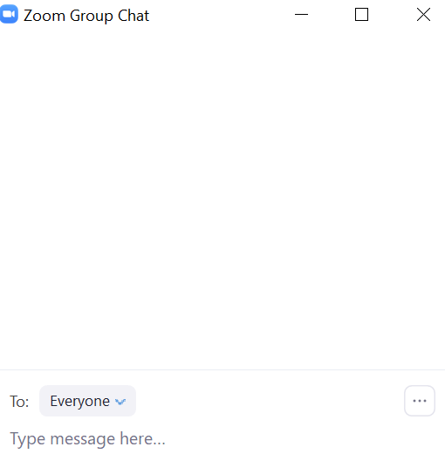
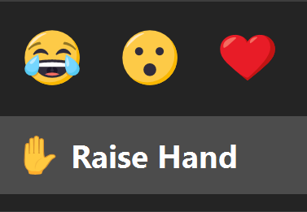
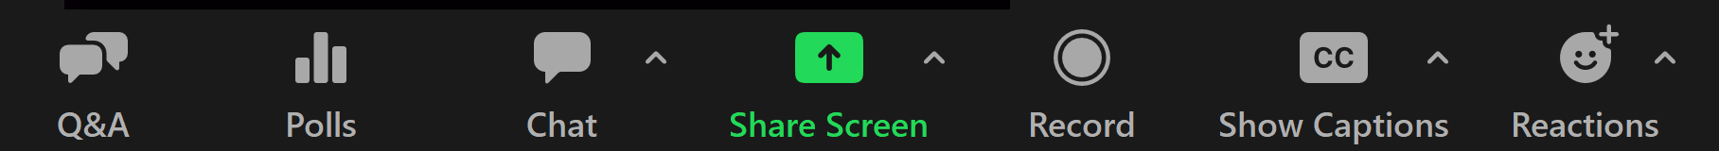
Using Zoom
Join the Discussion
Enable Closed Captions and Show Subtitle or View Full Transcript
Use the chat to share your thoughts, experiences and resources
Notes:
Lily - A quick reminder before we get started: you can use the chat to share your thoughts, questions, and resources throughout today’s session. Closed captions are available if you’d like to turn them on.

Slide 4

Give the Chat a Try!
If Rapid Insight could instantly answer one question for you,
what would it be?
Which students are most likely to leave before the spring term?
Will my child change their mind about their Halloween costume unexpectedly?
How many emails will be waiting when I check my inbox after this session?
Which advising strategies will have the biggest impact on retention?
or something else!
Notes:
Lily - To warm us up, let’s start with a lighthearted icebreaker. If Rapid Insight could instantly answer one question for you—about your students or even your personal life—what would it be? For example: Which students are most likely to leave before the spring term? Or… will my child change their Halloween costume at the last minute? Pop your answers in the chat!

Slide 5
Strategy Spotlight: Improving Fall-to-Spring Retention with Rapid Insight
October 9, 2025
Notes:
Lily

Slide 6
Session ROADMAP
1
Overview & Objectives
2
IR’s Role in Retention
3
Partner Spotlight: Penn State University
4
Demo: Identifying Early Indicators in Rapid Insight
5
Applying Insights on Your Campus
Notes:
Lily - Here’s our roadmap for the session:
We’ll start with an overview and objectives.
Then talk about IR’s role in retention.
Next, we’ll spotlight Penn State’s story.
We’ll show a short demo of Rapid Insight in action.
And finally, we’ll close with practical steps you can take back to campus this fall.

Slide 7
Today’s Objectives
Use Rapid Insight tools to analyze the effectiveness of student support structures.
1
2
Recognize early indicators of student attrition before final grades or official withdrawals are available.
3
4
Identify practical, low-lift strategies your IR or student success teams can implement this fall to strengthen retention efforts.
Showcase an example of how to use Rapid Insight to partner with advising units and impact student success.
Fall is a critical window for attrition risk, and the IR office can play a unique role in bringing actionable data forward.
Notes:
Lily - Our goals today are to:
Recognize early indicators of student attrition before final grades or official withdrawals are available.
Use Rapid Insight tools to analyze the effectiveness of student support structures.
Identify practical, low-lift strategies your team can use this fall to strengthen retention.
And showcase how Rapid Insight can help you partner with advising units to drive student success.

Slide 8
IR’s Role in Retention
Setting the Scene
2
Section
Notes:
Lily – Fall is such a critical window for attrition risk. And Institutional Research offices are uniquely positioned to surface data that others can act on quickly. Let’s talk about what that looks like.

Slide 9





IR’s Role in Retention
IR is uniquely positioned to:
Identify leading indicators of attrition
Translate complex data into insights advising units can use
Quantify the financial and student success impact of interventions
Consider: How can IR shift from simply reporting data to strategically advising through the data?
Notes:
Lily - IR teams can quantify the financial and student success impact of interventions, identify leading indicators of attrition, and translate complex data into insights advising units can really use. The key question is: how do we shift IR from just reporting data to strategically advising through the data?

Slide 10




Common Early Indicators of Attrition Risk
These leading indicators give institutions a chance to act before final grades or withdrawals are posted.
Academic
Not registered for next term
Multiple course drops/withdrawals
Low midterm performance
Advising & Engagement
No advising meetings documented
Limited use of support services
Low participation in campus activities
Behavioral
Low LMS activity (log-ins, submissions)
Frequent absences
Missing course materials
Financial
Account holds or late payments
Unmet financial need / aid changes
Notes:
Lily – These are some of the most common early indicators:
Academic: not registering for next term, course withdrawals, low midterm performance.
Advising & engagement: no advising meetings documented, low use of support services, limited campus involvement.
Behavioral: low LMS activity, frequent absences, missing materials.
Financial: account holds, aid changes, or missed payments.
The point here is that many of these signals show up well before grades are final or students formally withdraw.

Slide 11
Partner Spotlight:
Penn State University
Janet Schulenberg, Ph.D.
3
Section
Notes:
Lily – With that foundation in mind, let’s turn to a real-world example. Penn State University took a closer look at how advising influences persistence—and Rapid Insight was central to their work. Janet, I’ll turn it over to you to share your story.
We’ll have some time for questions for Janet at the end of these slides – please feel free to send your questions in the chat as we go.

Slide 12




The Pennsylvania State University (Penn State)
Public 4-year university in State College, PA
88,000+ undergraduates
system-wide
$1.034B in annual
research expenditures
17K Pell Grant
recipients
Notes:
Janet

Slide 13

One University, Geographically Dispersed
Partner Spotlight: Penn State University
Moving among units and campuses is the norm
Undergraduate students can begin at any Penn State campus and complete their degree at any other campus.
All students begin as pre-major students, many in a unit for exploratory students.
A Penn State course is a Penn State course, regardless of where it is taken.
Advisors must provide continuity while students move frequently throughout campuses.
80,000
250+
20
Undergraduate students
Baccalaureate majors
Undergraduate campuses
Source: Pennsylvania State University; EAB interviews and analysis.
Notes:
Janet

Slide 14

The Challenge
Partner Spotlight: Penn State University
Proving the Value of Academic Advising
3 Hurdles Facing Penn State’s Academic Advising in 2024
1
2
3
Budget & Staffing Pressures
Inconsistent Advising Experience
Data & Resource Limitations
New budget model + voluntary separation incentive program created risk of adviser position cuts
Needed to demonstrate the financial and student success impact of advising
Wide variation in advising models across campuses/colleges
Student feedback suggested inequitable experiences
IR capacity focused on reporting/accreditation
Key advising data (Starfish) not centrally available
Needed a tool beyond Excel/laptop analysis
Source Penn State University, EAB interviews and analysis
Notes:
Janet

Slide 15
The Solution
Partner Spotlight: Penn State University
Analyzing Large Advising Datasets with Rapid Insight
Data Analysis
Presence of any documented advising meeting
Student enrollment in subsequent term
Adviser role (faculty vs. professional)
Action
Adapted EAB ROI template for Early Alert to advising context
Demonstrated the financial and student success impact of advising
Partnerships
Collaboration between IR, advising staff, and academic affairs leadership
Shared results with leaders influencing structure, evaluation, and accountability of advising
Source Penn State University, EAB interviews and analysis
Notes:
Janet

Slide 16





Impact
Partner Spotlight: Penn State University
Now
Advising’s Well-Earned Seat at the Table
Key Findings from the Rapid Insight Analysis
Campuses set goals to increase intentional outreach and documentation
Students with a documented advising meeting were much more likely to return the following semester.
Documented meetings reduced URM-majority retention gaps; without advising, gaps widened.
Financial modeling showed millions in tuition revenue linked to advising-related persistence.
Units with stronger adviser accountability had higher rates of documented meetings.
Advisers evaluated on advising responsibilities were more likely to hold/document meetings.
Faculty Affairs exploring ways to include advising quality in evaluations
Academic affairs directors setting clearer expectations for faculty advising
Elevated advising as a strategic resource for persistence
Supported Faculty Senate recommendation to revisit advising’s structure and accountability
Source Penn State University, EAB interviews and analysis
Notes:
Janet

Slide 17
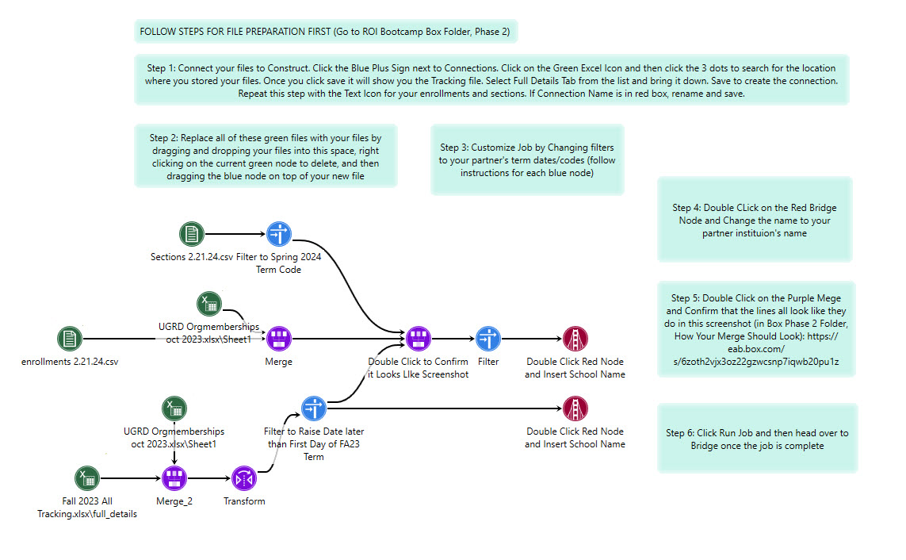
Step 1: Start Somewhere!
Partner Spotlight: Penn State University
Notes:
Janet: Starting Point: A Construct job built to look at ROI for students who had tracking items raised through course progress surveys

Slide 18
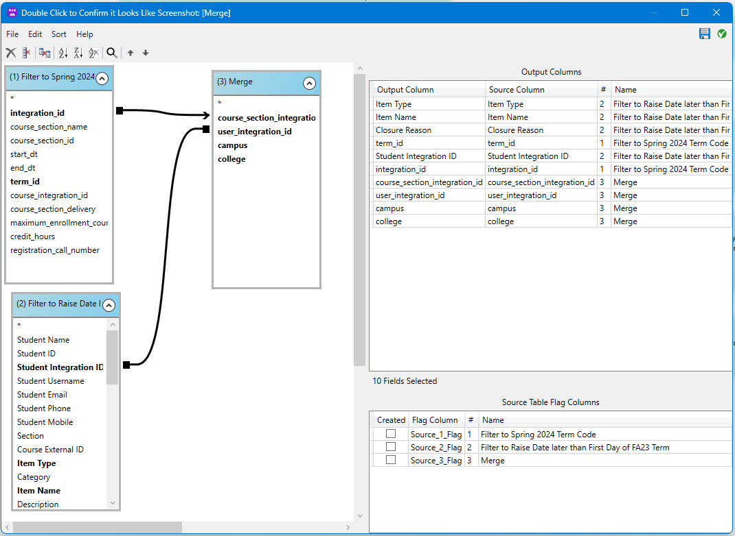
Step 2: Adapt the Job to Your Research Question
Partner Spotlight: Penn State University
Notes:
Janet - Adapting this model was because: we can’t control what a student does, but we can control how the institution supports them. What structures are in place to support them.
Construct is agile, it can adapt with you as your institutional structures are evolving.

Slide 19
Questions
Janet Schulenberg, Ph.D.
Senior Director, Undergraduate Studies
Penn State University
Notes:
Lily – open the floor to questions for Janet. Prepare a few questions in case it’s a quiet crowd.
Back Pocket Questions:
How did you go about sharing your findings with campus leaders, and what advice would you give others on getting leadership buy-in for investing in advising?
If another institution wanted to start a project like this, what’s one piece of advice you’d give them about where to begin?

Slide 20
Demo
Identifying Early Indicators in Rapid Insight
4
Section
Notes:
Lily
15- minute demo
Identify students not registered for next term
Call each for each adviser, create report for each adviser to reach out to their students who have not yet registered
Include:
Tips for communicating findings with advising units and leadership. How do you make this information approachable and actionable for leadership and advising staff?
Low-lift strategies for offices just beginning with predictive modeling.
Janet – Send Lily original Construct job and adapted job
Lily – Walk through one feature of the job. Offer a peek into how Penn State ran this job.
Keep in mind for Skills & Solutions: Next step from this: create an early-term retention model, then use Predict to give Student Success Offices a heads up on which students should receive targeted support.

Slide 21
Applying Insights on Your Campus
Where Will You Start?
5
Section
Notes:
Lily - Now let’s bring this back to your own institutions. Where will you start? Which of these early indicators are most relevant for you?

Slide 22
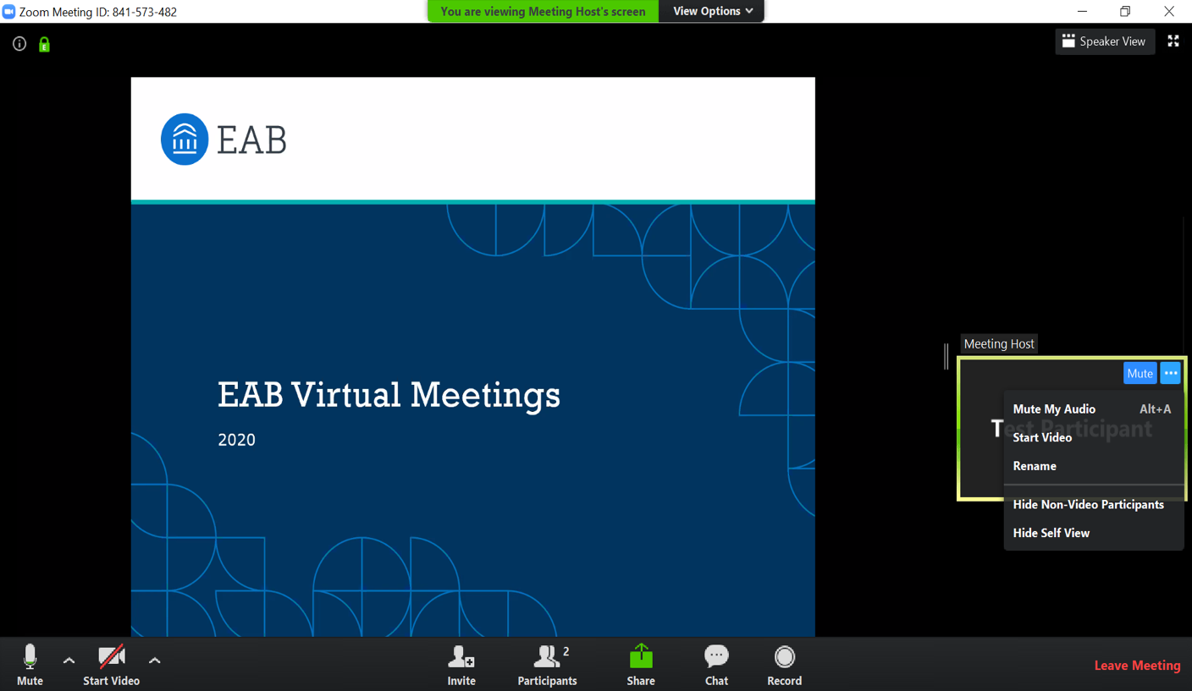
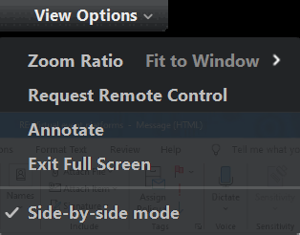
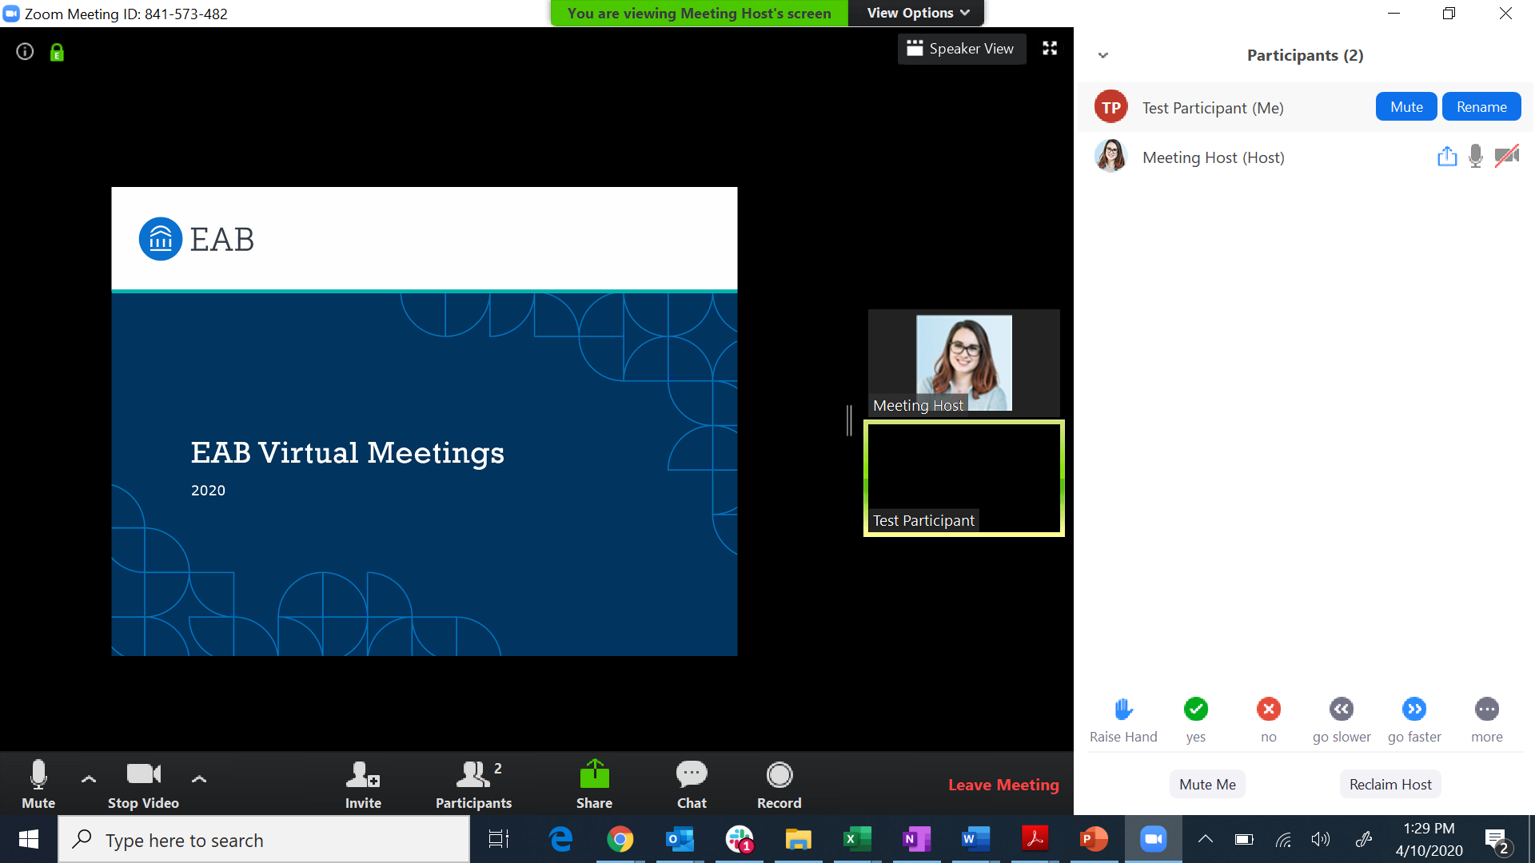
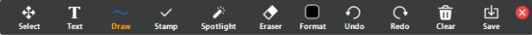
How to Use the Zoom Annotation Feature
Step 1: View Options, then Annotate.
Step 2: Panel with different options for annotation. Please select Stamp.
Notes:
Lily – To get you started thinking about how this all applies to your own campus, we are going to use the Annotate feature in Zoom. To annotate…

Slide 23
Where Will You Start?
Applying Insights on Your Campus
Which of these common early indicators of attrition are you interested in exploring?
Not registered for next term
Multiple course drops or withdrawals
No advising meetings documented
Low utilization of campus resources
Frequent absences
Account holds or late payments
Unmet financial need
Low midterm performance
Or something else? Tell us in the chat!
Notes:
Lily
Go ahead and stamp on the slide which of these early indicators of attrition you’re most interested in exploring through an analysis. You can start by finding the low-hanging fruit. Which of these common early indicators of attrition would be most accessible for you to focus on first? What data do you have easy access to?

Slide 24



Practical Next Steps
What You Can Do this Fall to Impact Retention
Identify a Risk Indicator
Start with the risk indicator you identified on the previous slide. Think: what student data do I have access to? What’s the low-hanging fruit for me to analyze?
Your Role Continues
Institutional Research’s role isn’t just identifying risk; it’s shaping institutional actions with your insight.
Determine Who You Need to Connect With
What departments or individuals will you work with to gather data and report your findings?
Work with them to uncover pain points, challenges, or analyses they want to explore.
Leverage Rapid Insight
Leverage the platform to identify early indicators of attrition, build a first-to-second term retention model, or correlate interventions to retention on your campus.
Notes:
Lily - Here are a few practical steps you can take this fall:
Identify one risk indicator you have data for—it doesn’t have to be perfect, just start somewhere.
Determine who you need to connect with—academic affairs, advising, student success teams.
Remember: IR’s role isn’t just to identify risk, but to help shape the institution’s response.
And finally, leverage Rapid Insight to explore early indicators, model retention, and connect interventions to outcomes.

Slide 25
Final Poll
Please provide feedback on today’s session.
After today’s session, how confident do you feel in identifying early indicators of fall-to-spring attrition at your institution?
Would you like us to register you for the next Skills & Solutions session on October 30?
Would you like to schedule a one-on-one meeting with Lily?
Notes:
Lily
Before you go, we’d love your feedback!
Let us know how confident you feel using Rapid Insight now, and whether you want to join our next session or get personalized support.

Slide 26
Next Steps
On-Demand Resources
Want Help with Your Retention Model this Fall?
Follow along with our Three-Part Retention Modeling Cohort to:
Translate raw data into a predictive model
Score students on their risk of attrition
Explore and refine your understanding of students’ challenges
Rapid Insight Skills & Solutions Session
October 30 | 2:00-2:45PM ET
Join us for a quick, low-pressure training session to enrich your retention modeling practice.
Schedule a One-on-One Session
Meet with Lily to brainstorm project ideas or get help with a current project. Sign up in the poll.
Notes:
Lily -
Ready to keep going? Join our next Skills & Solutions Session on October 30 for hands-on tips and peer examples.
Or book a 1:1 with me to brainstorm your project or talk through your dataset.
And don’t forget—we’ve got a full library of Help Center articles, webinars, and blog posts to guide you.

