Slide 1

Expanding Your Data Capabilities through Edify’s Rapid Insight Access
Strategy Spotlight
October 3, 2025
Notes:
Kurtis
Rapid Insight offers a powerful suite of self-service analytics tools designed to help you prepare data, build predictive models, and create interactive cloud-based dashboards with ease. Edify partners receive complimentary access to Rapid Insight, unlocking new opportunities to maximize their data strategy.
Join us for an interactive session to discover how Edify and Rapid Insight work seamlessly together to empower hands-on data exploration, streamline compliance reporting, and scale your analytics capabilities. We’ll showcase examples of how partners are already leveraging both platforms to meet institutional goals, including successful state reporting initiatives.
In this session, you’ll learn how to:
Supercharge your data workflows by integrating Rapid Insight with Edify
Build multi-source reports in minutes
Dive into no- or low-code data exploration and analysis
Expand data access, enabling more staff to participate in data-driven projects
Take advantage of complimentary Rapid Insight access through your Edify partnership
Who should attend?
This session is ideal for both technical and non-technical users – anyone interested in leveraging Rapid Insight, from data reporters and request managers to data consumers eager to self-serve and explore data independently.

Slide 2

Give the Chat a Try While Others Join!
Give the Chat a Try!
What are you looking forward to this weekend?
Notes:
Kurtis

Slide 3
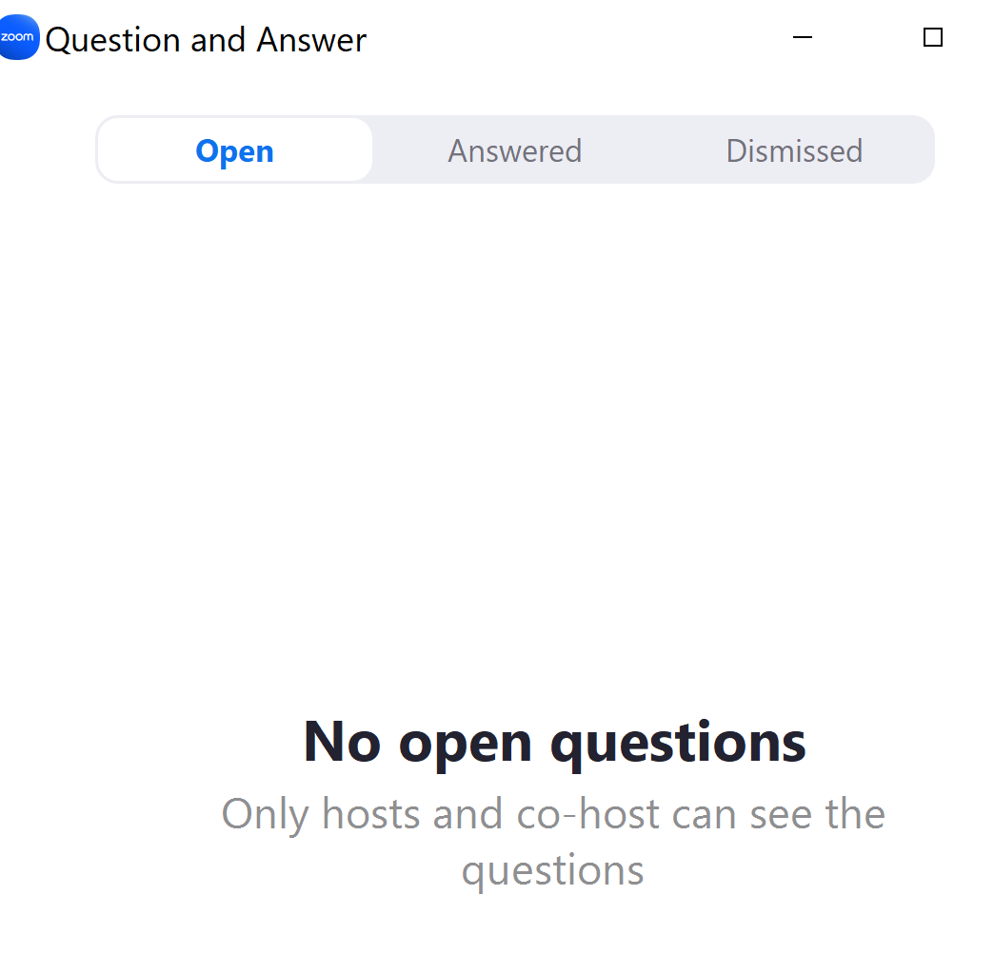


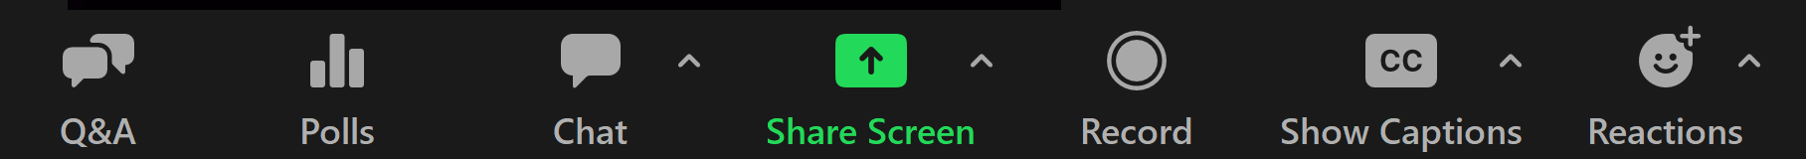
Zoom Features
Ask a Question
Join the Discussion
Enable Closed Captions and Show Subtitle or View Full Transcript
Use the Q&A to ask a question or view previous questions asked
Use the chat to share your thoughts, experiences and resources
Notes:
Kurtis

Slide 4
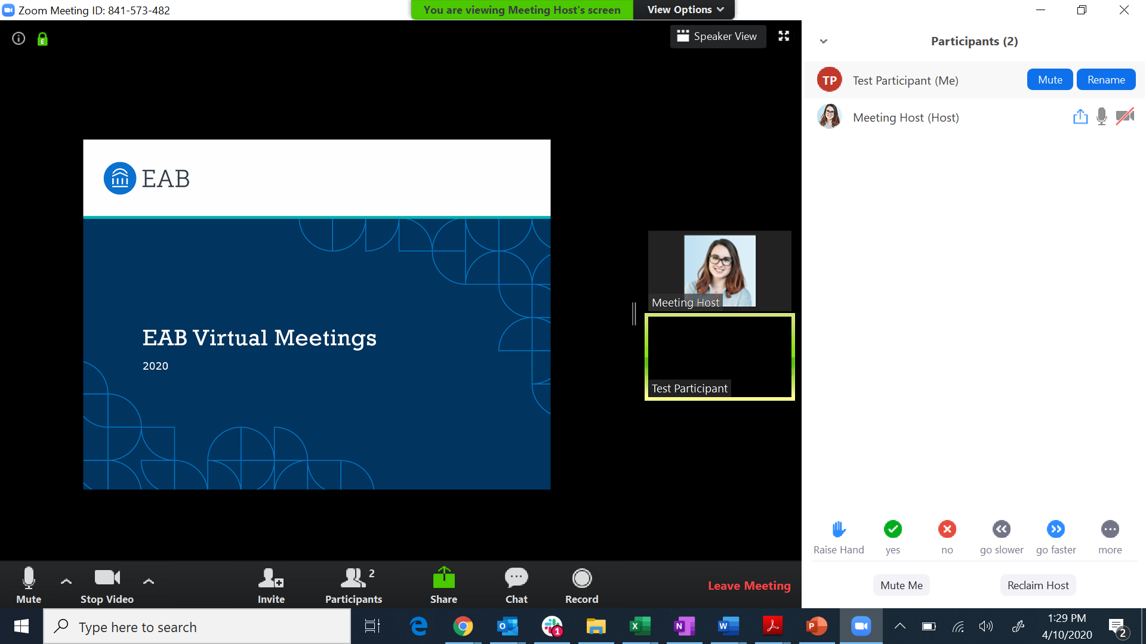

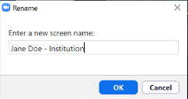
Please Update Your Name and Institution
Update your name and add your institution
Open Participants menu
Notes:
Kurtis

Slide 5
Expanding Your Data Capabilities through Edify’s Rapid Insight Access
Strategy Spotlight
October 3, 2025
Notes:
Kurtis

Slide 6


Today’s Facilitators
Lily Brennan
Strategic Leader,
Data and Analytics
lbrennan@eab.com
Kurtis Hagans
Senior Strategic Leader,
Data and Analytics
khagans@eab.com
Session materials will be available online and shared in follow up
Notes:
Kurtis/Lily

Slide 7



Goals for Today’s Session
Understand How Rapid Insight Can Help
Learn how it complements Edify for quick, flexible data analysis and reporting.
Inspire Action Through Peer Examples
Explore how Edify partners are solving real problems with Rapid Insight.
Know How to Get Started
Learn how to access Rapid Insight and walk away with ideas on how to leverage it to support your work.
Notes:
Kurtis

Slide 8
1
Edify and Rapid Insight
2
Creating an Edify Connection and Transforming Data in Construct
3
How Edify Partners Have Used Rapid Insight
4
Q&A and Closing
Notes:
Kurtis

Slide 9
Poll Question
How would you describe your institution’s current use of the Rapid Insight software?
Notes:
Kurtis
We are actively using it
We are aware of it, but not using it at all
We don’t know much about it and aren’t using it
Unsure
Other: Please enter your response in the Chat!

Slide 10
Edify with Rapid Insight
Centralized Data
Decentralized Activation
Bring Your Data Together
Access and Warehousing
Build a Culture of Data Confidence
Data Governance
Empower Your Team with Insight
Reporting and Analytics
Cloud-native, secure, infinitely scalable data lake and warehouse to support critical institutional use cases
Higher ed best-practice rules and validations to ensure golden record/ single source of truth
Self-service, custom, and pre-built analytics to drive efficiency and/or support decision-making
Data ingestion through a library of pre-built higher ed system connectors or custom extraction
Data consolidation and previewing across sources
Downstream data delivery and system integration
Data transformation
Snapshotting
Data archiving and back-ups
Full ‘glass box’ higher ed best-practice data model
Data dictionary
Data lineage
Data profiling and quality assessment
Validation rules
Permissions management
Data processing logs and monitoring
No or low code data exploration, analysis, and ad hoc reporting
Operational and compliance reporting
Data visualization through your preferred business intelligence tools
Pre-built, customizable analytics for higher ed
strategic use
Self-service predictive modeling
Build Your Team’s Capacity
Professional Service Hours
Strategy and
Culture Support
Process
Consulting
EAB support to meet you where you are: Your team’s use of Edify can be self-service, partially-, or fully-managed by EAB.
Integration
Services
Data Science and Analysis
Notes:
Kurtis
So to help our partners face these challenges when it comes to fulfilling compliance and reporting needs, we have a variety of offerings included in your Edify partnership.
So the first is the core platform of Edify itself, allowing you to have a centralized data lake and data warehouse that serves a central source of truth and encompasses critical data warehousing features, like snapshotting and data archiving.
Edify is also helping to build that foundation that enables data governance on campus, with features like our embedded data dictionary and data lineage.
But we also offer ways to empower teams in a decentralized way which is where Rapid Insight comes into play…

Slide 11
Rapid Insight’s Self-Service Analytics Technology
Engage in No- or Low-Code Data Exploration, Analysis, and Reporting
Construct a Data-Informed Environment
Build Dynamic Reports from Diverse Data Sources
1
Gather data sources
Access, prepare, and explore your data in a code-free but code-friendly environment suited for all skill levels
2
Merge dispersed data sources
Analyze data from SIS, CRM, LMS, databases, data warehouses, text files, and spreadsheets
3
Cleanse and transform the data into reports and generate re-usable workflows
Predict Institutional Outcomes
Self-Service Analytics for Scale
Build custom, automated predictive models for institutional and student success
Fulfill Ad Hoc and Short-Term Reporting
Miscellaneous compliance reporting (IPEDS), National Student Clearinghouse, accreditations, etc.
Build models for admission and enrollment, student success, institutional research, advancement, and more
Create Scale and Save Time
Quick, up-to-speed analyses enabling a broader user base to interact with the data
Sources: Edify and Rapid Insight.
Notes:
Lily
Construct – is a data preparation tool that allows you to automate a bunch of the manual manipulations you may do to data on a recurring basis.
Predict – is a self-service tool for predictive modeling and allows you to find correlation in variables to outcomes
Using these tools independently, you can connect to multiple data sets, including Edify – build models to support institutional initiatives – and export that data to individual workbooks, Tableau, or publish to Bridge.

Slide 12
When to Use Edify or Rapid Insight
Consider Using Either Technology If Any of Their Boxes Are Checked
Edify
Rapid Insight
Data user is part of the Edify Leadership Team
Data user is external to the Edify Leadership Team
User prefers a coding interface
User prefers drag-and-drop interface
Project uses data in Edify
Project uses data outside of Edify
Project requires dynamic data visualizations
Project can be satisfied with basic data reporting layouts
Project involves consultative data science
Project involves in-house predictive modeling
Sources: Edify and Rapid Insight.
Notes:
Lily

Slide 13
How to Access Rapid Insight
Edify partners can access Rapid Insight complimentarily by indicating so in our closing poll question today or reaching out to your Strategic Leader.
Notes:
Lily

Slide 14
1
Edify and Rapid Insight
Creating an Edify Connection and Transforming Data in Construct
2
3
How Edify Partners Have Used Rapid Insight
4
Q&A and Closing
Notes:
Lily

Slide 15



Working in Construct
Loading and Exploring Data
Connecting to data sources
Quick exploration
Load data from various systems into Construct
Rapid Insight is ideal for:
Connect directly to Edify, Navigate360, Starfish, and other data systems
Combine and explore data all in one location
  Ad hoc requests
  Data exploration
  Combining and cleaning data to feed dashboards
  Fleshing out proof of concept reports that will be formalized in Edify (or other platforms) later
Sources: Edify and Rapid Insight.
Notes:
Lily

Slide 16
Poll + Chat Questions
1
Are there data sources that are historically difficult to investigate and would be valuable to investigate in a non-enterprise environment?
2
Are there data sources that you prefer not to keep in Edify, but want to analyze?
3
If you answered yes, what data sources? Please list in the Chat.
Notes:
Lily

Slide 17
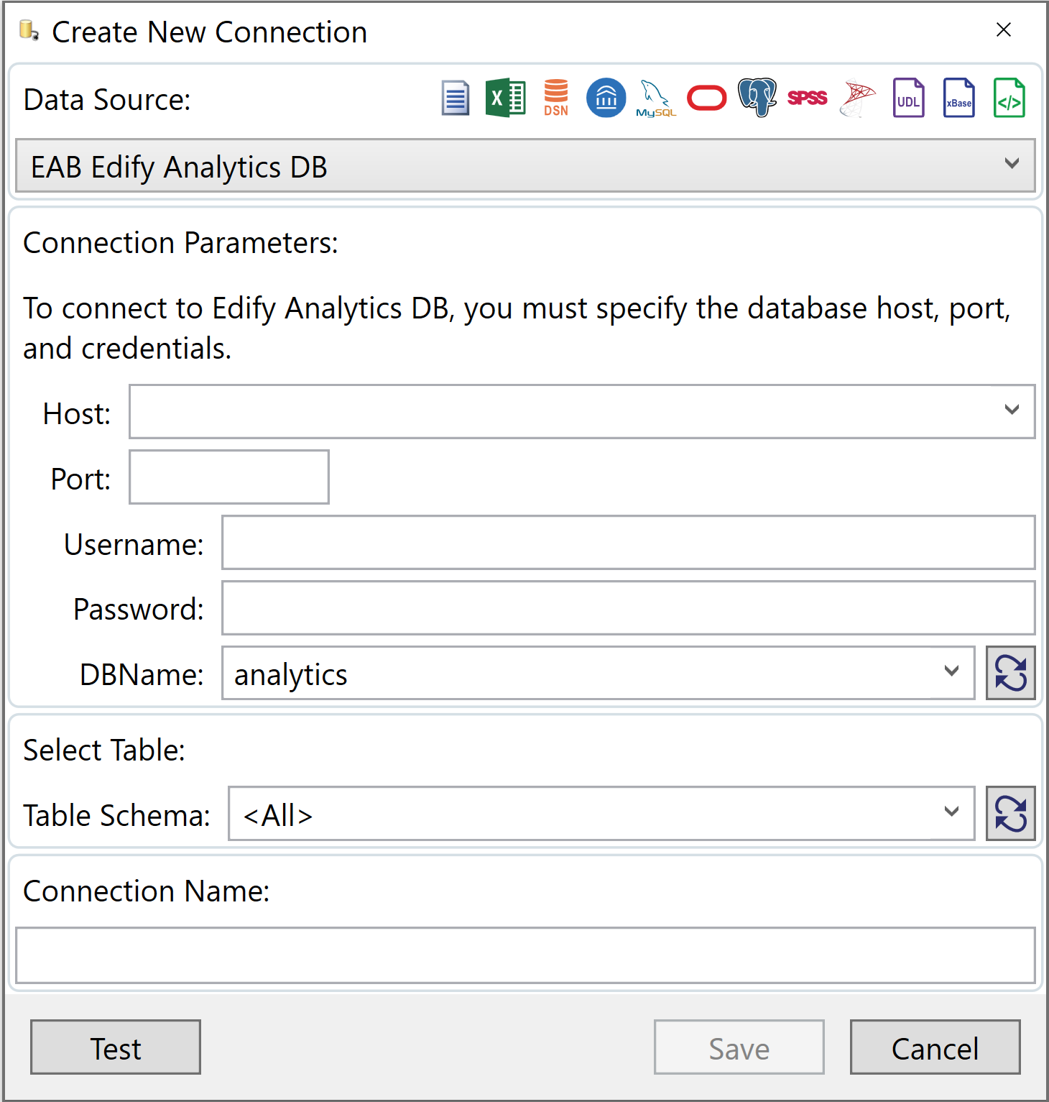
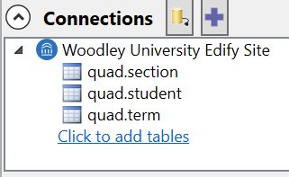
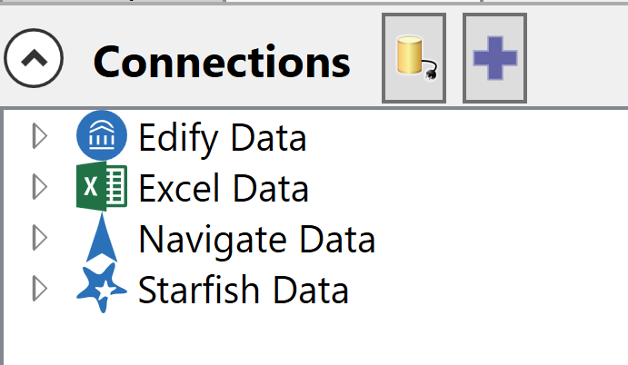
Connecting to Data Sources in Three Steps
Easily Connect and Combine Data in Rapid Insight
1
Connecting to Edify is as easy as pulling the Analytics DB (database) credentials from Edify, meaning any user can easily access the data.
2
The Edify connection gives you access to explore Quad tables as well as any sources that have been mapped to Edify.
3
Rapid Insight allows you to connect to and combine data from many sources in one location.
Sources: Edify and Rapid Insight
Notes:
Lily

Slide 18
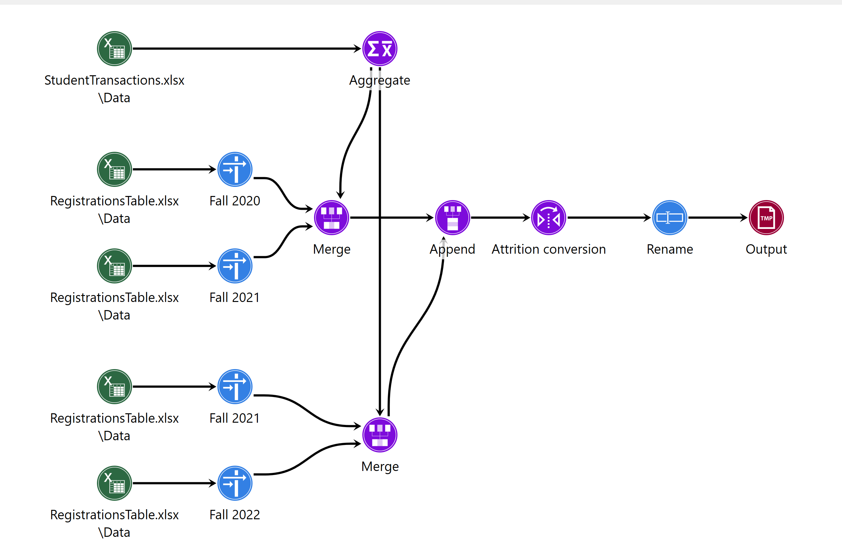
Automating Routine Processes to Save Time
Build Reusable Workflows to Automate Reports in Construct
Schedule reports
Refresh data automatically on a scheduled cadence
No Code Required (But Can Be Integrated)
Easy to share and interpret
Reusable Workflows
Ideal for routine reports so you never have to start from scratch
Refresh your data and make quick process adjustments without needing to sift through lines of code or remembering a click path
Sources: Edify and Rapid Insight
Notes:
Lily
Note: Animations on slide

Slide 19

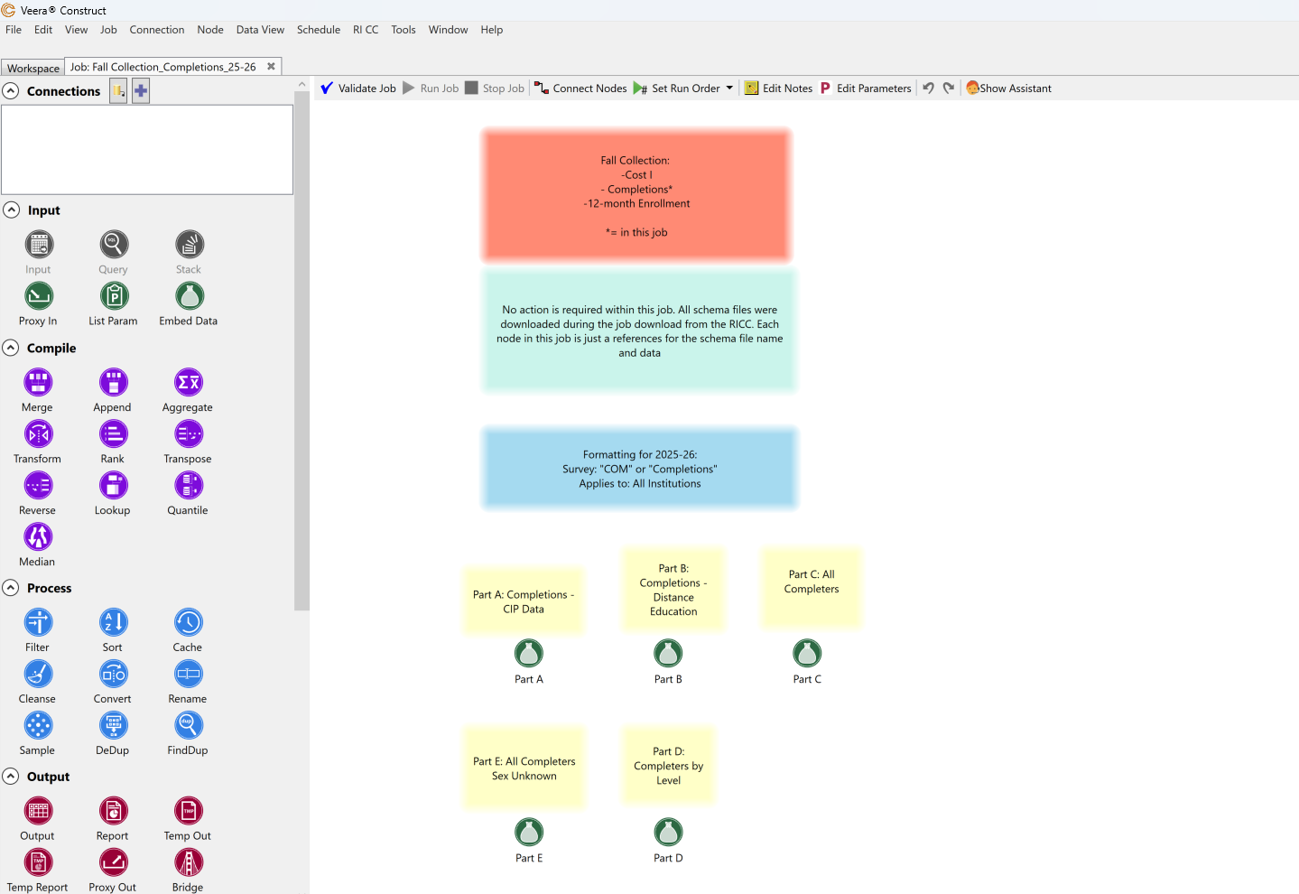
Save Time with IPEDS Formatting in Construct
Create an Automated Process to Prepare IPEDS Data
Replace NSC with IPEDS
Format IPEDS data as a fixed width file to upload directly into the IPEDS submission portal
Save time and manual efforts by importing data which is more efficient and less prone to human error
Download and apply formatting requirements directly from the RI Collaborative cloud (updated for each survey and submission cycle)
Easily make updates and re-use your data preparation workflow each year instead of starting from scratch
Partner with RI SL to save time on IPEDS reporting
Direct-to-Portal Upload
Format IPEDS data as fixed-width files for seamless upload into the IPEDS submission portal.
Efficiency and Accuracy
Reduce manual work and human error by importing data with a repeatable, automated process.
Reusable and Always Updated
Apply current IPEDS formatting rules from the RI Collaborative Cloud and easily re-use the workflow each submission cycle.
Source: Rapid Insight.
Notes:
Lily
Finally, for those not familiar with Rapid Insight, we do offer a number of “Quick Starts” or templatized ways to get started to meet your needs based on systems of record and what you are looking to do. We have quick starts for student success, enrollment, and incorporating IPEDS data into your ecosystem.
What RI helps with that Edify doesn’t: Row positioning and labeling in Edify is tedious when a row has null values / RI – position the nodes visually in the order that you need them and connect them – easier to do that in Edify

Slide 20

Live Demonstration – Rapid Insight
Notes:
Lily
Live demo of creating Edify connection
Then demo create working report in RI
Longer term, plug it into Edify for routine decision-making

Slide 21
1
Edify and Rapid Insight
2
Creating an Edify Connection and Transforming Data in Construct
How Edify Partners Have Used Rapid Insight
3
4
Q&A and Closing
Notes:
Kurtis intro UWA

Slide 22


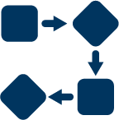

Scaling Compliance with Rapid Insight
The Office of Institutional Effectiveness at the University of West Alabama are transforming a time-intensive process—updating over 1,600 data quality reports—into a scalable, automated workflow using Construct. In one instance with their Alabama State Reporting, what used to take more than 18 hours per term can now be completed with several clicks. With dynamic parameters, cross-departmental coordination, and automated outputs across 85+ fields, UWA’s new system ensures data accuracy while freeing up staff time for deeper analysis and faster corrections.
20 min intro + upfront
10 min demo
10 min UWA
10 min Northampton
5 Q&A with them
5 min wrap up
Before Edify/RI: they were using business objects (a reporting tool associated with Colleague). The reports were complex/hard to maintain/lot of manual effort.
brought relevant data into Edify Build Zone
Created an export for ACHE.
Pulled exports into RI to automatically fix data types and establish width/etc. for formatting.
Time savings
  Edify data transformation + snapshotting with RI to streamline a multi day process into a single day
Edify Team + Lily as resource = ACHE was once owned by a resource that left UWA so they were put in a bind when that happened/now Renee and Bliss own and extending their team to EAB has eliminated operational redundancies
Updating over 1,600 data quality reports into a scalable, automated workflow using Construct
Impact
In one instance with their Alabama State Reporting, what used to take more than 18 hours per term can now be completed with several clicks
With dynamic parameters, cross-departmental coordination, and automated outputs across 85+ fields, UWA’s new system ensures data accuracy while freeing up staff time for deeper analysis and faster corrections.
Faster, Easier ACHE Reporting Through Automation
OPPORTUNITY
USING RAPID INSIGHT
IMPACT
Time-Consuming Process
Automating ACHE Reporting with Rapid Insight
Impact
18
BusinessObjects platform from Colleague was used for Alabama Commission on Higher Education (ACHE) reporting requirements
Reporting was complex, difficult to maintain, and required manual effort
UWA updated over 1,600 data quality reports into a scalable, automated workflow in Construct
Hours saved per term
1
Ingested relevant data into the Edify Build Zone
Greater Scale
By streamlining a multi-day process into a few clicks and leveraging EAB staff as an extension of their team
2
Created an export for ACHE
3
Pulled exports into Construct to automatically fix data types and establish required ACHE formatting
Source: The University of West Alabama; EAB interviews and analysis.
Notes:
Kurtis

Slide 23

Replicating State Reporting After Losing Access to Metrics
Overcoming Reporting Gaps from System Transition
System Migration Interrupts Access
Using Rapid Insight
Impact
What’s Next?
The Wisconsin Technical College System (WTCS) transitioned to PowerBI
Gateway Technical College (GTC) lost access to certain metrics calculated by WTCS using GTC data
Prototyped a workflow in Construct mirroring the WTCS reporting
Replicated the state’s reporting cohort definitions
Able to expand on the data that the state provided them since it is now an in-house process
Greater data access and transparency
Ability to explore and use the data without having to go through the state
Incorporating the data into Edify as a more systematic process once they perfect the logic in Rapid Insight
Opportunity
Rapid Insight
Impact
Future Plans
Source: Gateway Technical College; EAB interviews and analysis.
Notes:
Kurtis

Slide 24

Turning Complex Data into Everyday Insights
We needed to give authorized staff a way to pull, manipulate, and output authoritative data without requiring training on SQL or the like.
We have been using Rapid Insight for about three years. We have multiple folks using it for a variety of projects.
Generally, a 1) small team of data developers create core data sets in Edify's Build zone. 2) These, as pre-vetted sources, can feed a variety of outputs including Rapid Insight's Construct tool. 3) Construct then allows subject area experts who have knowledge of the data and reporting needs to interface with these data sets in an easy-to-use drag-and-drop interface. 4) In some cases, we're able to bring in third-party data (say from a student survey), correlate it to the existing data models, and draw new insights without having to write a single new join!
We have seen massive time savings, plus an increased willingness to rely on authoritative data sources. The addition of Construct into our workflows has gone a long way to breaking down long-standing data silos. All this, and we've barely scratched the surface of what the tool can do. When asked about time savings – Brian said: I'd be hard pressed to put a number on it.. For us it's less about time saving and more about making the impossible possible.. basically, it broadens the pool of talent we can draw on to help build out our data ecosystem. Most of the stuff we do in Construct we either wouldn't have been able to do previously, or we would have needed to wait for a SIS report writer to be available. Not sure if that helps or makes sense.
Edify and Construct together make working with data fun!
Breaking Barriers and Saving Time with Rapid Insight
Access to Self-Service Analytics
  Rapid Insight at Northampton
New, Deeper Insights
Users generate insights, sometimes bringing in third-party data (e.g., survey) and correlating it to existing models
Ability to Pull, Manipulate, and Output Authoritative Data
No SQL Training Required
Data Silo Breaking
Long-standing data silos have been broken down and there is stronger trust in authoritative data sources
  Create Data Sets in Edify
  Small team of data developers create core data sets in the Build Zone
  Export Data
  Pre-vetted sources feed various outputs, including Construct
Make the Impossible Possible
Construct enables more individuals to contribute to the data ecosystem
  Leverage Construct
  Subject area experts interact with the data in an easy-to-use drag-and-drop interface
Edify and Construct make working with data fun!
Source: Northampton Community College; EAB interviews and analysis.
Notes:
Kurtis

Slide 25
1
Edify and Rapid Insight
2
Creating an Edify Connection and Transforming Data in Construct
3
How Edify Partners Have Used Rapid Insight
4
Q&A and Closing
Notes:
Lily

Slide 26
Poll Questions
1
How was today’s session?
2
Are there specific users at your institution to whom you would like to extend an invitation to use Rapid Insight? If so, please provide their names and email addresses.
3
Would you like to be registered for any upcoming Rapid Insight or Edify sessions?
4
Additional follow-up requests or comments?
Thank you for joining us today!
Notes:
Lily
October 9th Strategy Spotlight: Improving Fall-to-Spring Retention with Rapid Insight
October 23rd Edify Quarterly Product Roadmap
October 29th Edify Feature Focus: Pipeline and Smart Reports
October 30th Rapid Insight Skills and Solutions session
Nov 5th Strategy Spotlight: How to Prepare Your Campus Data Ecosystem for an AI-Powered Future
Nov 20th Edify Feature Focus: Operational Reports
December 4th Rapid Insight Skills and Solutions session

Slide 27
Q&A
Submit a Question Using the Chat, Raise Your Hand, or Come Off Mute
Lily Brennan
Strategic Leader,
Data and Analytics
lbrennan@eab.com
Kurtis Hagans
Senior Strategic Leader,
Data and Analytics
khagans@eab.com
Notes:
Lily

Slide 28



Key Takeaways From Today’s Session
Rapid Insight is a valuable companion tool to Edify, allowing users to engage in no- or low-code data exploration, analysis, and ad hoc reporting regardless of their historic role in your Edify processes.
Edify partners have used Rapid Insight to fulfill reporting needs by creating re-usable Construct workflows.
As an Edify partner, you already have access to Rapid Insight. Let us know if you’d like to obtain a software license for your own use, extend an invitation to any colleagues, or learn more about the tool!
Notes:
Lily

